Slide 1
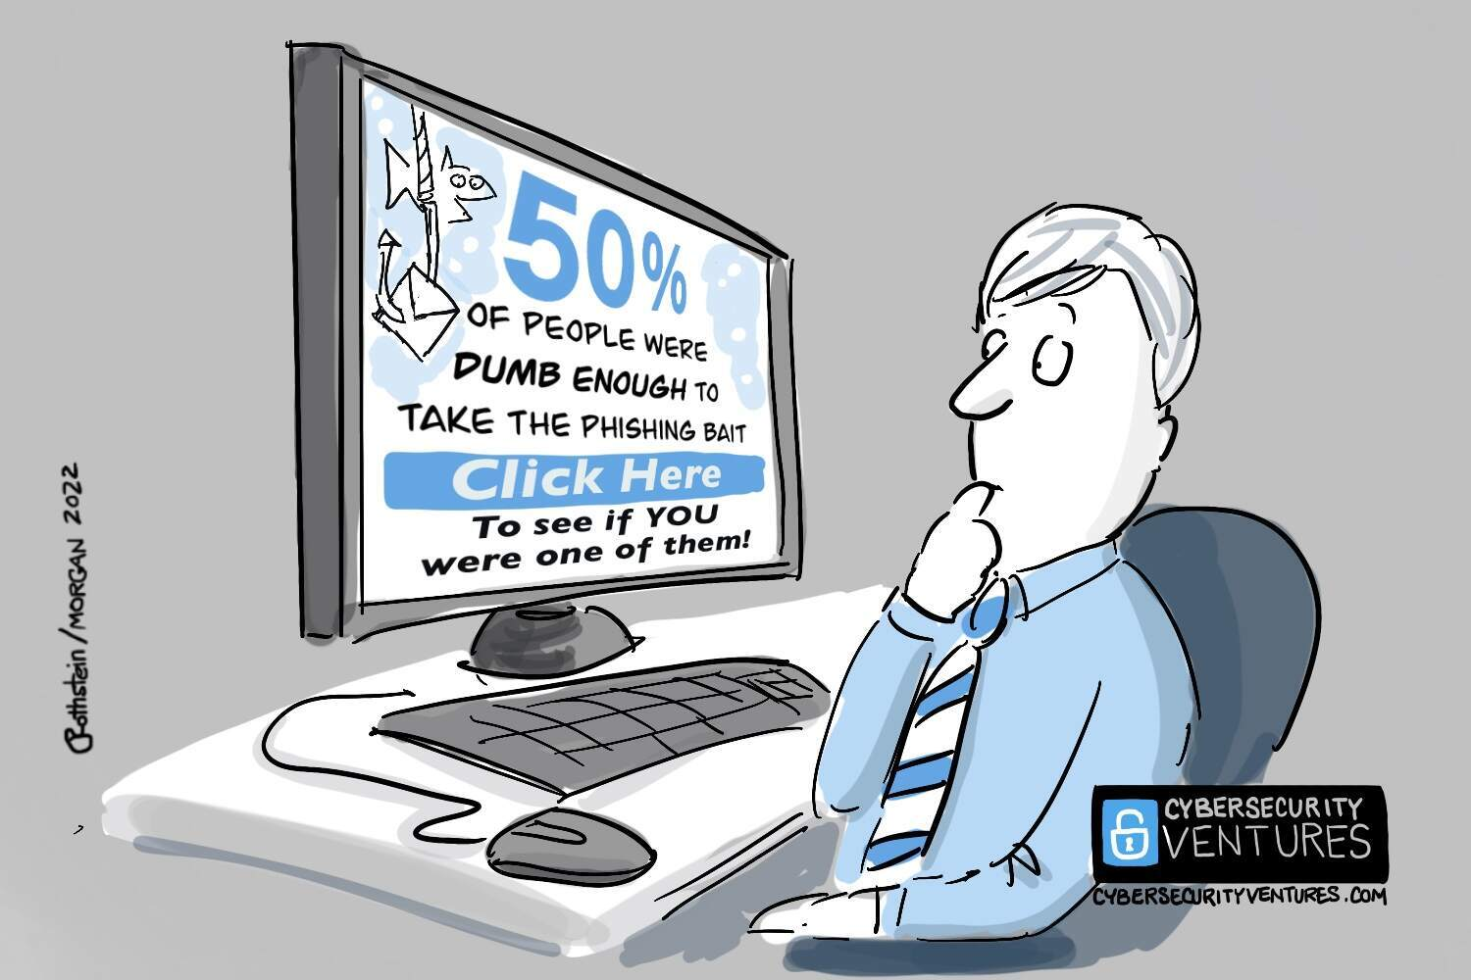
Cyber Risk Intelligence Center
Placeholder for optional client logo
India Knowledge Service
Marsh McLennan Cyber Risk Intelligence Center

Slide 2
Assignments in detail
Steps to be followed :
You have been given few PDF’s where you have to read these files in python
You need to work on any one of the below two assignment :
Paragraph items text extraction and parsing
Tabular items extractions and transformation
Assignment 1
For paragraphs text parse the data on paragraphs level and have to store the parsed items in data frame object in a way that for every new paragraph there should be new line entry in row.
For all the paragraphs you find info numerical information's like count/currencies you have to create a flag against them as “num_flag”. Please refer to the attached excel format for the expected results.
Further you need to return the list of all numerical values for given paragraphs in num_list column.
Assignment 2
For tabular Items you have to return them in to data frame object . All the tabular item then have to be transformed in to two generic column name called “dimension” and “measures”.
All the non numerical columns has to be concatenated on dimension columns and all the numerical fields should be parsed in Measure columns (in case of multiple numerical columns you need to transform the columns into rows). Please refer to the attached excel format for more details.

Slide 3
Assignment submission SOP
Key Notes:
Steps to be followed :
Download the attachments
Open the python note book(Jupiter notebook or Google collab (need to be submits back downloading the collab note book))
Please put comments/markdown’s in detail wherever is required.
Once you are done with the assignment please save the note book.
Save the file in a folder named as Assignment_[Your Name]
Zip the folder with Winzip
Share it back as a reply to same email you receive assignment.
Basic do’s and don’ts
Please use appropriate number of cells for each piece of work to be completed
It is mandatory to put comments/markdown in detail about each function and object you define.
The results should be shared only on (.xlsx) or (.csv) format (no other format will be entertained)
Please do not put this ppt. or assignment pdf into zip folder while sharing it back. Only share the notebook file and the results excel/csv in zip folder.
You can use all the open source python libraries.

Slide 4
Questions?

